Slide 1

Probability & Statistics
Shubhankar
HPC - AI
Mines Paris – PSL
Under the guidance of professor Dr. Miguel Munoz Zuniga (IFPEN)

Slide 2
Project Master
Parameter estimation of the Gamma distribution
Simulate an a posteriori distribution with the Monte Carlo Markov Chain algorithm
Calibration of the hyper-parameters of a gaussian pro- cess regressor by maximum likelihood
Mutual information and kernel density estimator

Slide 3
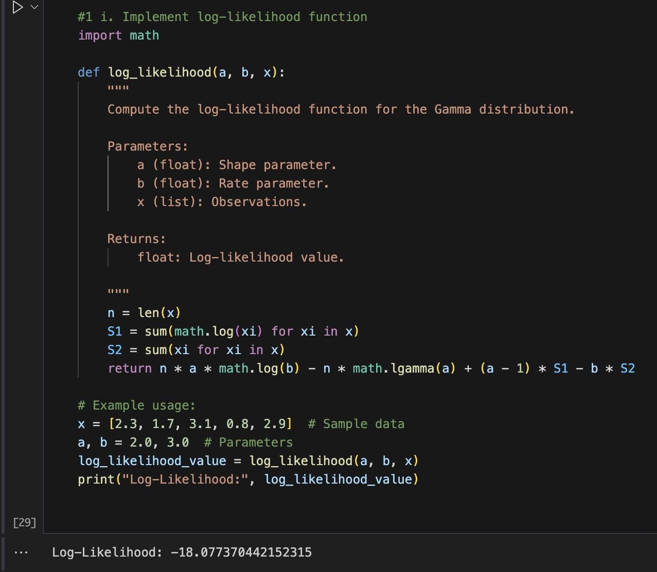
Log Likelihood
Notes:
Overview of the Task
The Gamma distribution’s probability density function (pdf) for an observation x (with parameters a and b) is given by:
f(x; a, b) = [b^a / Γ(a)] · x^(a – 1) · exp(–b*x) for x > 0
Rather than multiplying these probability densities—which can lead to numerical underflow—we work with logarithms. The log-likelihood for n independent observations {x₁, x₂, …, xₙ} becomes:
L(a, b; x) = n * [a * log(b) – log(Γ(a))] + (a – 1) * Σ(log(xᵢ)) – b * Σ(xᵢ)
This is exactly what our code implements.
────────────────────────────── Step-by-Step Code Explanation
Importing Necessary Functions
import math
The math module provides essential mathematical functions. In particular, math.log computes the natural logarithm, and math.lgamma computes the natural log of the gamma function (i.e., log(Γ(x))). Reference: Python’s math module (https://docs.python.org/3/library/math.html
)Defining the log_likelihood Function
def log_likelihood(a, b, x):
This function takes three inputs: - a – the shape parameter - b – the rate parameter - x – a list (or iterable) of observations
Adding Documentation (Docstring)
The docstring explains what the function does, the parameters it accepts, and what it returns. This is a best practice for writing clear code and is useful when working with colleagues or preparing slides.
Counting the Number of Observations
n = len(x)
Here we simply determine how many data points we have. In the likelihood formula, you need to know "n" because some terms (like n * [a * log(b) – log(Γ(a))]) scale with the number of observations.
Computing Summations
S1 = sum(math.log(xi) for xi in x) S2 = sum(xi for xi in x)
– S1 calculates the sum of the logarithms of each observation (Σ log(xᵢ)). – S2 computes the sum of all observations (Σ xᵢ).
These correspond directly to the Σ(log(xᵢ)) and Σ(xᵢ) terms in our log-likelihood formula.
Returning the Log-Likelihood Value
return n * a * math.log(b) - n * math.lgamma(a) + (a - 1) * S1 - b * S2
Breaking down each term: - n * a * math.log(b): This computes n times a times the logarithm of b. - – n * math.lgamma(a): Since math.lgamma(a) computes log(Γ(a)), multiplying by n gives the summed log-Gamma values (with a negative sign). - (a - 1) * S1: Multiplies (a – 1) by the sum over log(xᵢ). - – b * S2: Subtracts b times the total of the observations.
This directly mirrors the log-likelihood formula for the Gamma distribution.
Example Usage
x = [2.3, 1.7, 3.1, 0.8, 2.9] # Sample data a, b = 2.0, 3.0 # Parameters log_likelihood_value = log_likelihood(a, b, x) print("Log-Likelihood:", log_likelihood_value)
This snippet sets up some example data and parameters, calls the log_likelihood function, and prints the result. It’s useful for verifying that your implementation works as expected.
────────────────────────────── Key Points & Best Practices
Always include a clear docstring to explain the purpose of your function and its parameters.
Use math.lgamma when you need the log of the gamma function to avoid numerical instabilities from very large or small numbers.
Breaking the calculation into parts (like S1 and S2) not only helps readability but also mirrors the mathematical summation.
────────────────────────────── Online Code References
For further reading or reference when writing similar code, check out:
Python’s math module documentation: https://docs.python.org/3/library/math.html
(See math.log and math.lgamma for details.)
Wikipedia page on the Gamma distribution: https://en.wikipedia.org/wiki/Gamma_distribution
Python’s PEP 8 guide: https://peps.python.org/pep-0008/
(for best practices and code style)
────────────────────────────── Summary
This function efficiently computes the log-likelihood of a Gamma distribution given a list of observations and parameters (a and b). Each part of the code corresponds to a piece of the mathematical formula, and its implementation follows standard practices in Python programming.
Feel free to copy this explanation into your slides. Let me know if you need any more details or further code explanations!

Slide 4
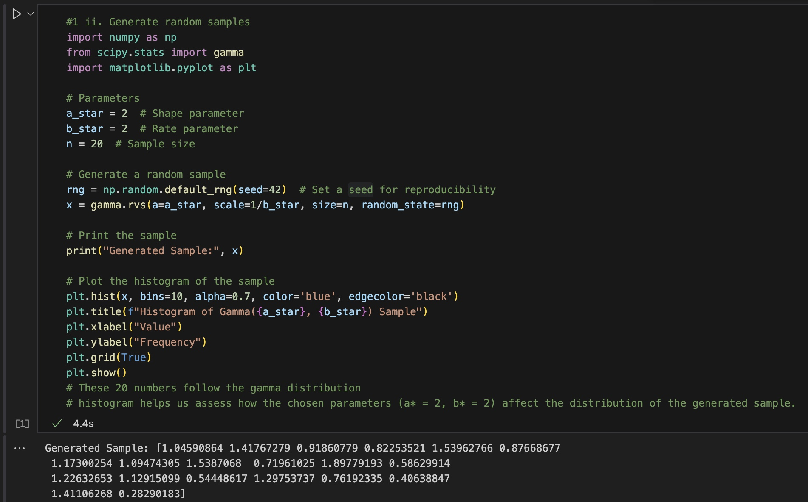
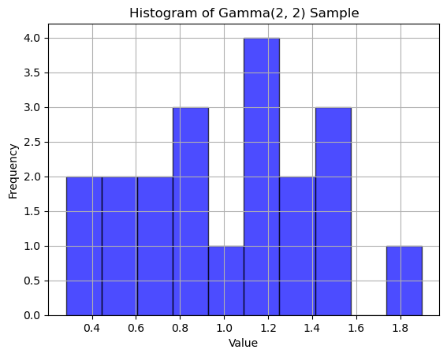
Random Samples

Slide 5
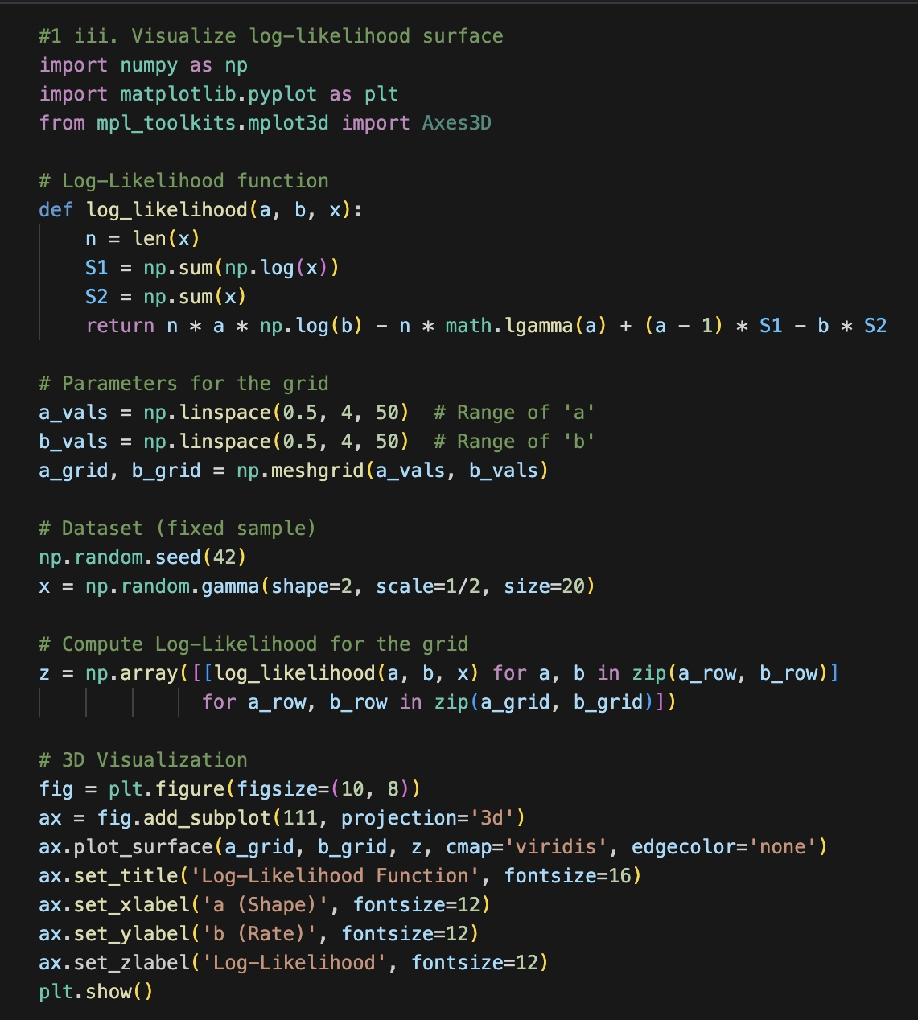
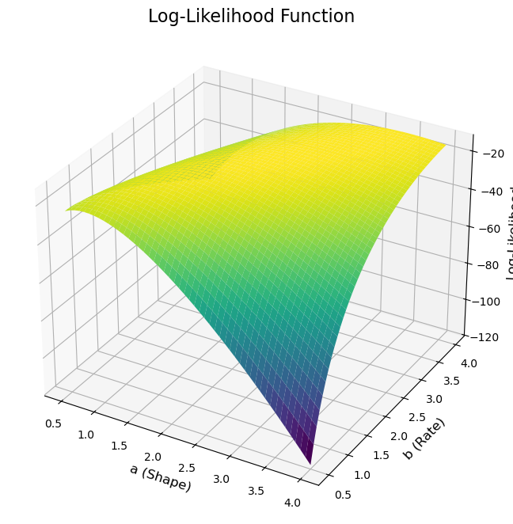
Visualize Log Likelihood surface
Numpy
scipy.stats.gamma is > generate random variates from the Gamma distribution
matplotlib.pyplot
x = gamma.rvs(a=a_star, scale=1/b_star, size=n, random_state=rng)
Notes:
x = gamma.rvs(a=a_star, scale=1/b_star, size=n, random_state=rng) – Here, gamma.rvs generates random variates from the Gamma distribution: – The parameter “a” is the shape (set to 2). – The “scale” is set to 1/b_star. Since b_star = 2, scale = 0.5. – “size=n” tells the function to generate 20 values. – “random_state=rng” ensures that the generator instance created earlier is used for sampling.
- plt.hist(x, bins=10, alpha=0.7, color='blue', edgecolor='black') – This command creates a histogram with 10 bins for the array x. – The alpha parameter makes the bars 70% opaque. – The blue color and black edges improve the readability. - plt.title(f"Histogram of Gamma({a_star}, {b_star}) Sample") – The title clearly describes that the data comes from Gamma(2, 2). - plt.xlabel("Value") and plt.ylabel("Frequency") – These label the x-axis (the observed values) and the y-axis (how often they occur). - plt.grid(True) – This adds gridlines to the plot for better visual aid. - plt.show()

Slide 6
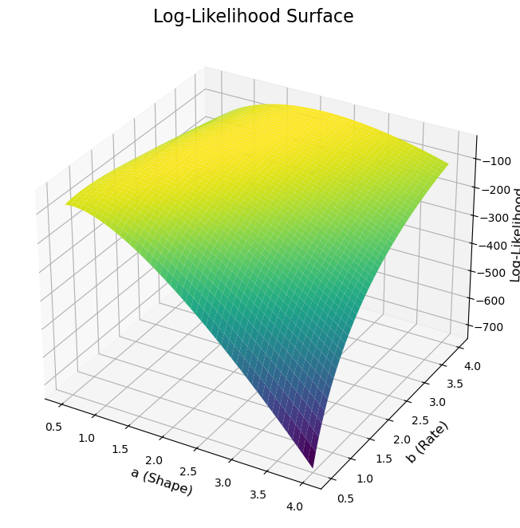

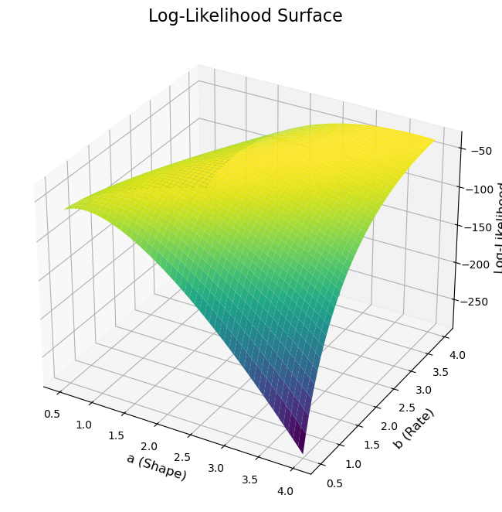
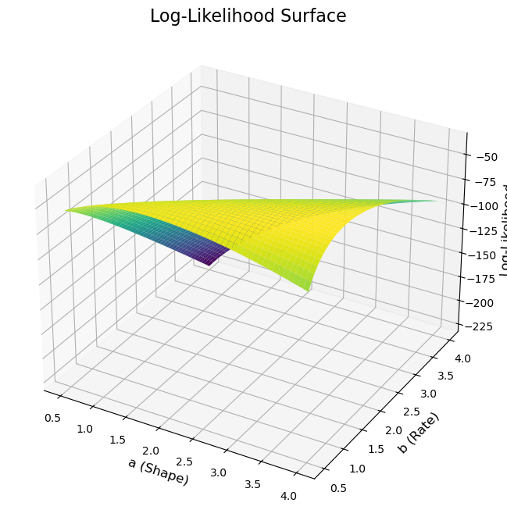
Plots
# The log-likelihood function typically has a smooth, concave surface. It forms a "dome" shape.
# log-likelihood function appears to have a single critical point.
# This critical point is a global maximum, as evidenced by the single peak in the surface plots.
# The maximum of the function is generally located near the true parameter values used to generate the data.
# a* = 2, b* = 2, n = 20: Broad peak near (2, 2) , Indicates parameter uncertainty
# a* = 2, b* = 2, n = 50: Sharper peak closer to (2, 2) , Shows improved estimation with larger sample
# a* = 3, b* = 1, n = 20: Elongated surface, Peak shifted towards higher 'a' and lower 'b'
#a* = 1.5, b* = 2.5, n = 100: Very sharp, well-defined peak, Maximum close to true values, Demonstrates benefit of large sample size
Notes:
Log likelihood 2 2 20
2 2 50
3 1 20
1.5 2.5 100

Slide 7
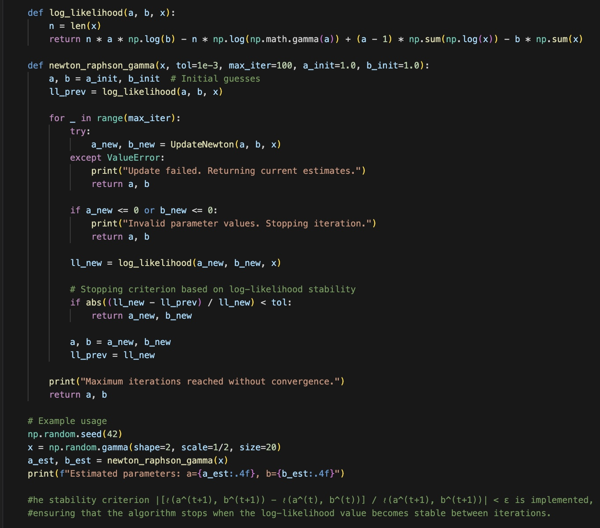
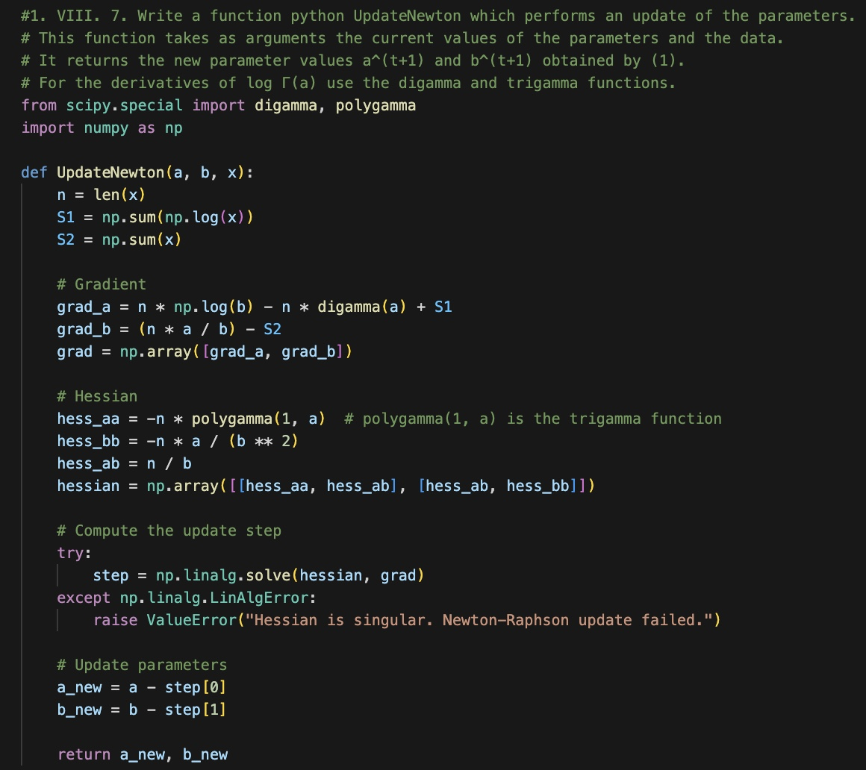
Newton Raphson Gamma
a. Initialize a and b from the given initial guesses. b. Compute the gradient components: grad_a = n·log(b) – n·digamma(a) + Σ[log(x)] (digamma(a) is the derivative of log(Γ(a)); ) – grad_b = n·a/b – Σ[x] c. Compute the Hessian (matrix of second derivatives): hess_aa = –n·polygamma(1, a) (polygamma(1, a) is the trigamma function) hess_bb = –n·a/(b²) hess_ab = n/b (the mixed partial derivative) d. Solve the linear system (Hessian · step = gradient) for the update step. e. Update a and b: a_new = a – step and b_new = b – step1. f. If either new value is nonpositive, the loop stops (this check is important because the Gamma parameters must be positive). g. The stopping criterion is based on the relative change in the log-likelihood. If convergence is reached within max_iter iterations, the function returns the new estimates and the number of iterations; otherwise, it returns the last computed values.
https://docs.scipy.org/doc/scipy/reference/special.html#digamma
https://en.wikipedia.org/wiki/Newton%27s_method
Notes:
a. Initialize a and b from the given initial guesses. b. Compute the gradient components: – grad_a = n·log(b) – n·digamma(a) + Σ[log(x)] (digamma(a) is the derivative of log(Γ(a)); see https://docs.scipy.org/doc/scipy/reference/special.html#digamma
) – grad_b = n·a/b – Σ[x] c. Compute the Hessian (matrix of second derivatives): – hess_aa = –n·polygamma(1, a) (polygamma(1, a) is the trigamma function) – hess_bb = –n·a/(b²) – hess_ab = n/b (the mixed partial derivative) d. Solve the linear system (Hessian · step = gradient) for the update step. e. Update a and b: a_new = a – step and b_new = b – step1. f. If either new value is nonpositive, the loop stops (this check is important because the Gamma parameters must be positive). g. The stopping criterion is based on the relative change in the log-likelihood. - If convergence is reached within max_iter iterations, the function returns the new estimates and the number of iterations; otherwise, it returns the last computed values.

Slide 8
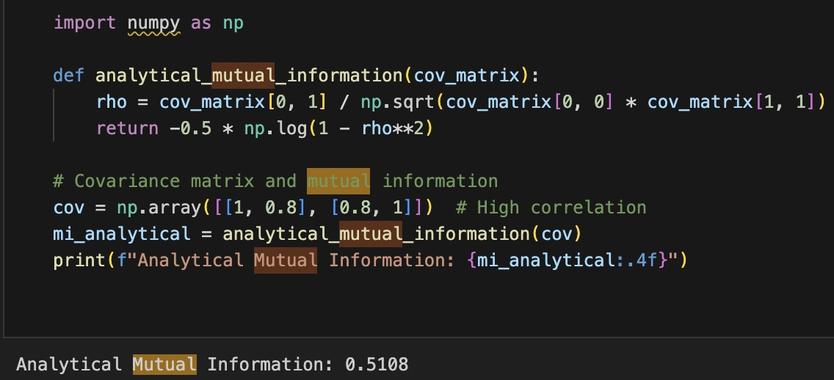
Mutual information and kernel density estimator

Slide 9
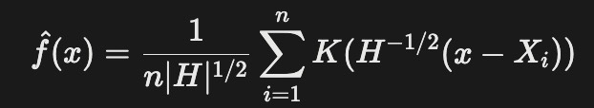
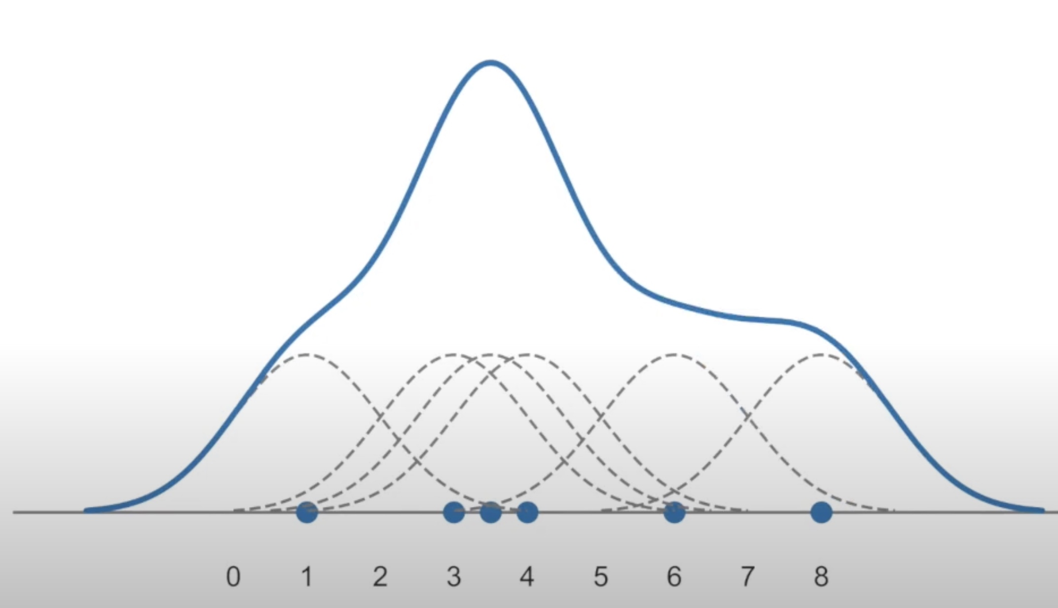
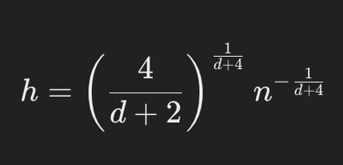
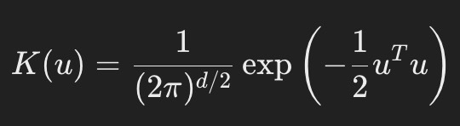
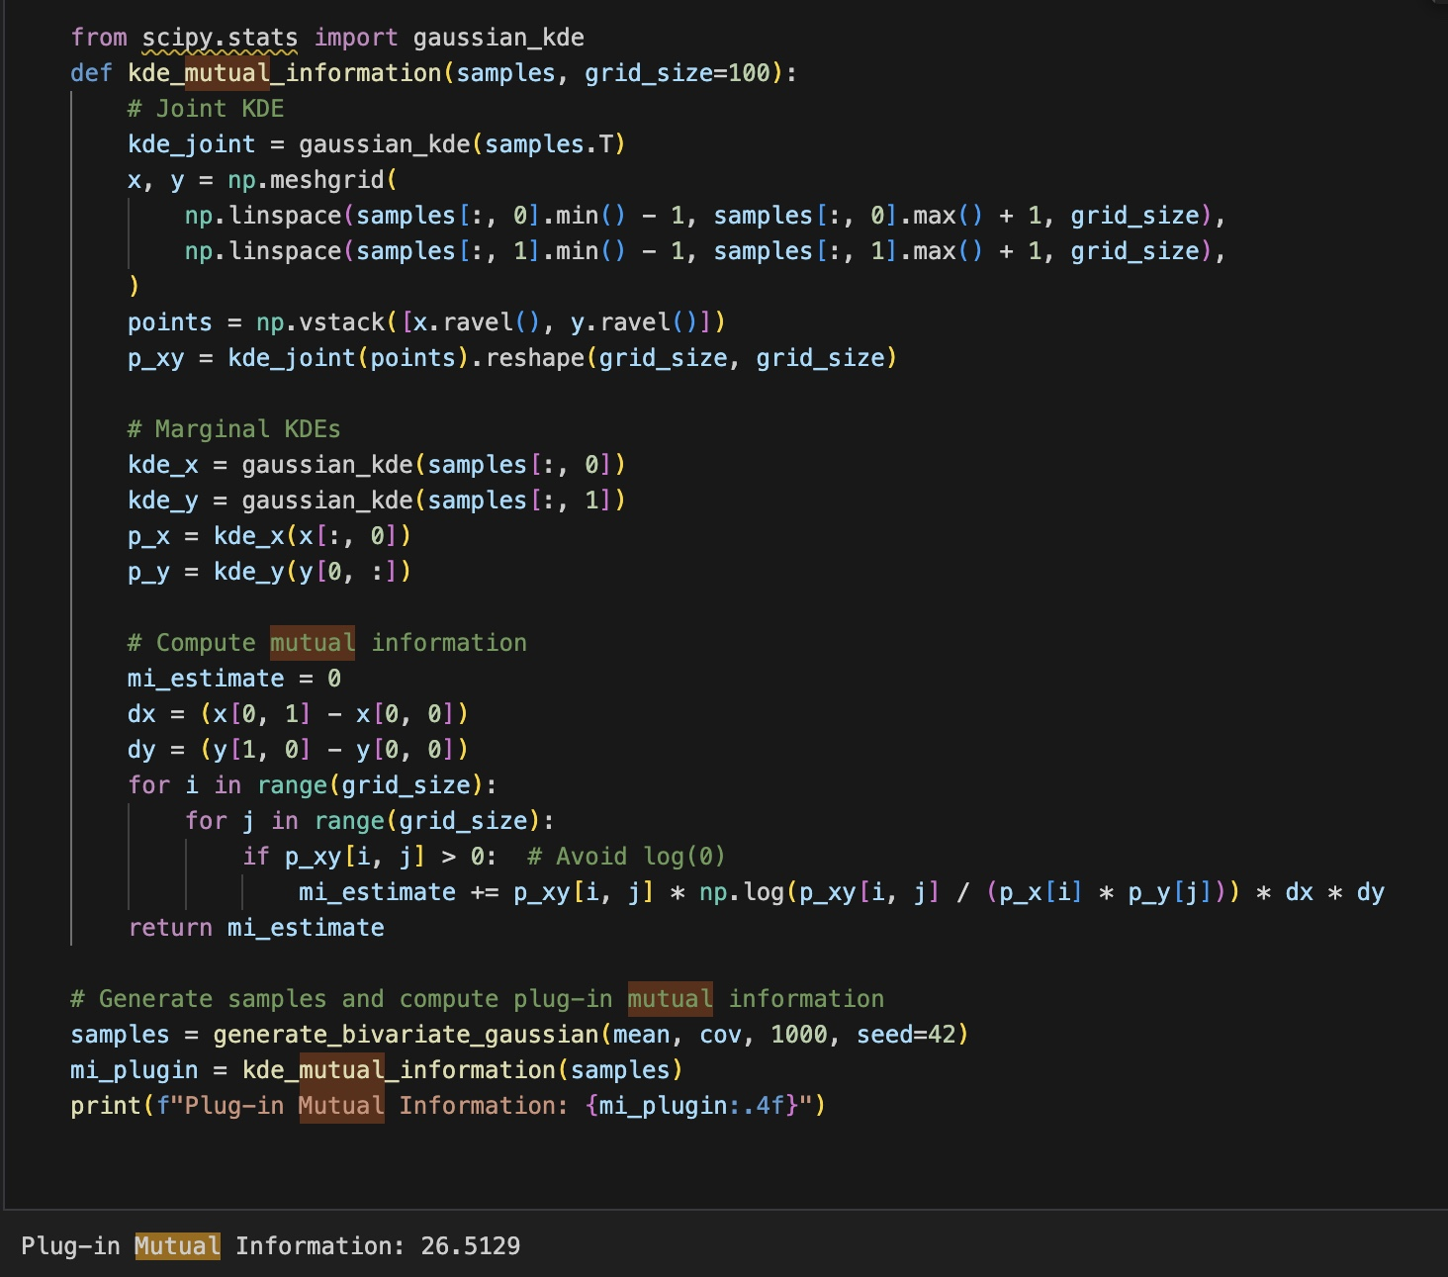
Mutual information and kernel density estimator
Bandwidth
Gaussain Kernal Formula
Mutual Information
MI = –0.5 · log(1 – ρ²)
Notes:
Can start seeing more jagged peaks
Increase bandwidth too. Much, smooth out
Possibly lose out
Default is scott or silverman
Estimating
Bivariate KDE plot > contours?
Highest density closest to you

Slide 10
Calibration of the hyper-parameters of a gaussian process regressor by maximum likelihood
Defining a covariance function (kernel) that measures similarity between inputs.
Simulating a GP realization.
Computing the negative log marginal likelihood based on the chosen kernel and data.
Using an optimizer to adjust the hyper‐parameters to minimize the negative log marginal likelihood .
Notes:
Simulate realizations of a GP using the covariance matrix derived from the kernel
def squared_exponential_kernel(x1, x2, sigma_f, l): x1 = np.atleast_2d(x1).T x2 = np.atleast_2d(x2).T sqdist = np.sum(x1**2, 1).reshape(-1, 1) + np.sum(x2**2, 1) - 2 * np.dot(x1, x2.T) return sigma_f**2 * np.exp(-0.5 / l**2 * sqdist)

Slide 11
Calibration of the hyper-parameters of a gaussian process regressor by maximum likelihood
def covariance_function(x1, x2, lam):
diff = np.abs(x1 - x2.T)
return (1 + diff/lam + (diff**2)/(3*lam**2)) * np.exp(-diff/lam)
This kernel controls the smoothness of GP realizations through the length-scale parameter λ.
Larger λ values produce smoother functions, while smaller values increase variability
Gaussian Process
Compute covariance matrix using Equation
Generate correlated Gaussian samples via Cholesky decomposition
Multiple realizations demonstrate the prior distribution over functions
def simulate_gaussian_process(x, lam, sigma=1.0):
cov_matrix = sigma**2 * covariance_function(x, x, lam)
return np.random.multivariate_normal(np.zeros(len(x)), cov_matrix)
Notes:
Simulate realizations of a GP using the covariance matrix derived from the kernel
def squared_exponential_kernel(x1, x2, sigma_f, l): x1 = np.atleast_2d(x1).T x2 = np.atleast_2d(x2).T sqdist = np.sum(x1**2, 1).reshape(-1, 1) + np.sum(x2**2, 1) - 2 * np.dot(x1, x2.T) return sigma_f**2 * np.exp(-0.5 / l**2 * sqdist)

Slide 12
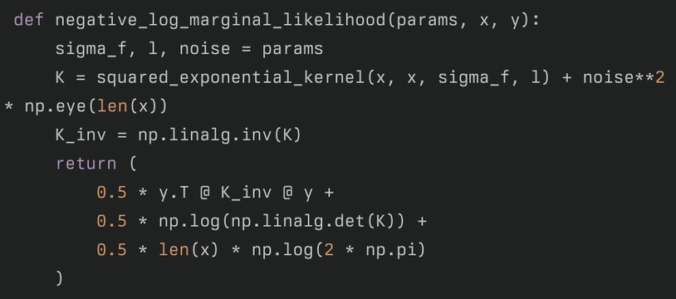
Calibration of the hyper-parameters of a gaussian process regressor by maximum likelihood
This function combines the data fit term (involving the covariance inverse and the response) with a complexity penalty expressed as the log determinant of the covariance matrix.
Method: Gradient descent on negative log-likelihood
Initial guesses (σ_f=1, l=1, noise=0.1)
Output: Estimated σ_f, l, noise values
Experiment: Change sample size (n=50 vs n=200) to see parameter convergence
Notes:
Data fit term: yᵀK⁻¹y
Complexity penalty: log|K| Balances model accuracy and complexity
Data fit term: yᵀK⁻¹y
Sa
Convexity guarantees for Matern kernels
Regularization via 1e-6*np.eye ensures numerical stability
Bounds prevent unrealistic length scales

Slide 13
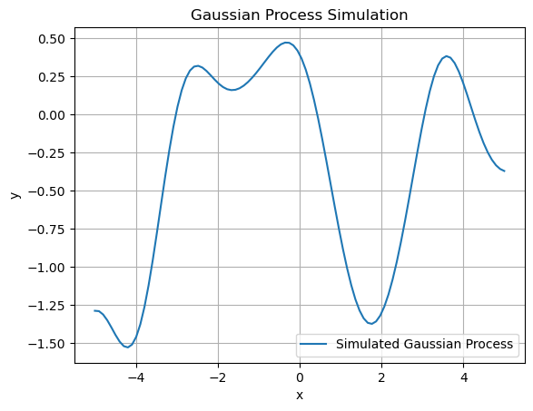
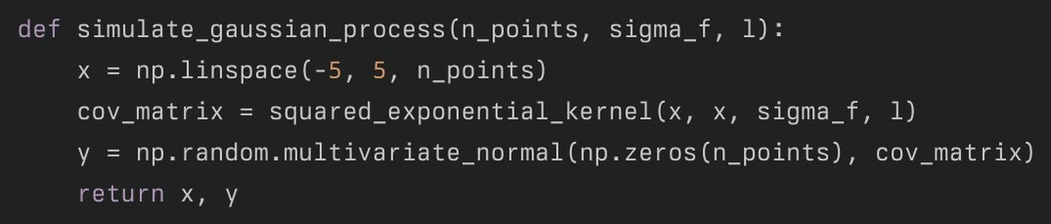
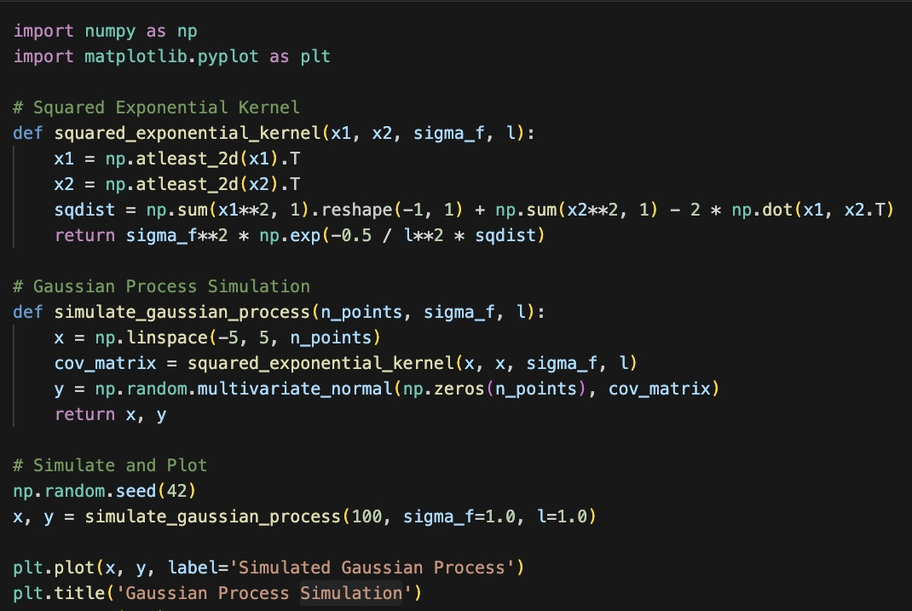
Gaussian Process
The function simulates a GP by drawing samples from a multivariate normal distribution using the kernel-generated covariance matrix

Slide 14
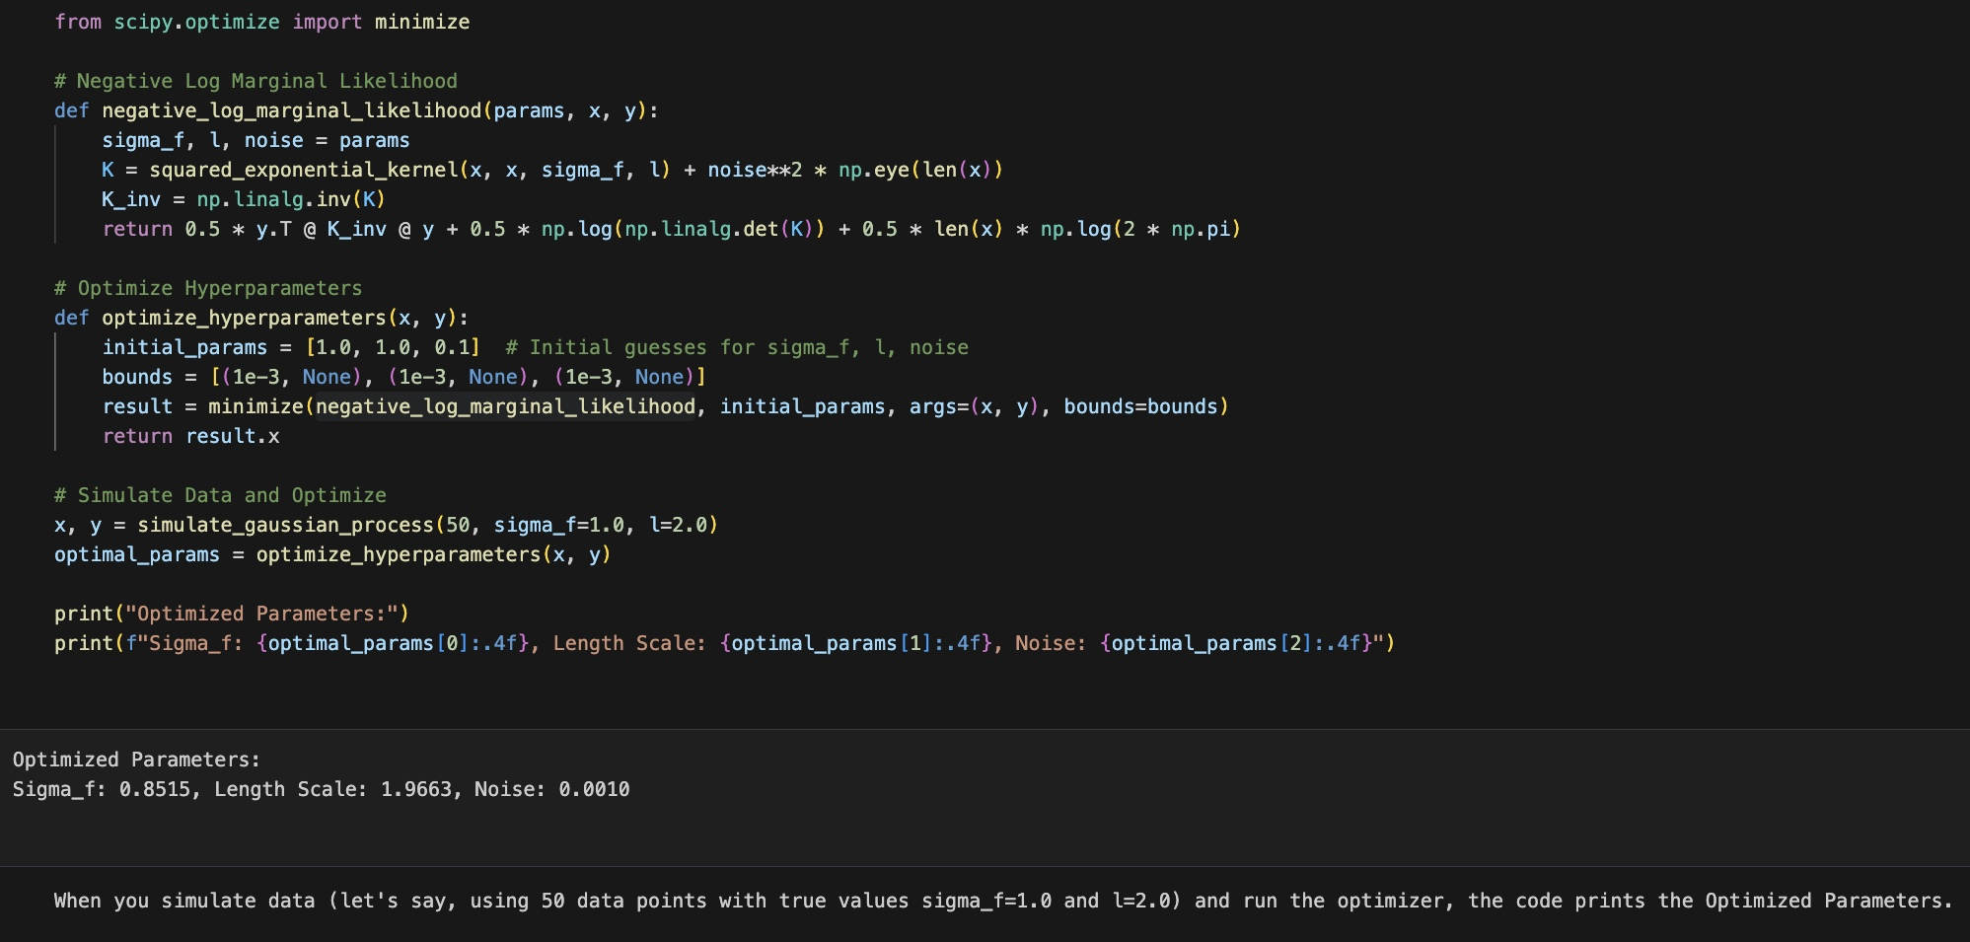
Optimized Hyperparameters
In Gaussian Process regression, the data are assumed to be drawn from a multivariate Gaussian defined by a covariance function (kernel).
Use squared exponential (Gaussian) kernel to construct the covariance matrix K for the training inputs x.
The GP model depends on hyperparameters:
σ_f (signal variance)
l (length scale
noise (observation noise level)
The marginal likelihood (or evidence) quantifies how well the hyperparameters explain the observed data y.
Notes:
We work with its logarithm for numerical stability.

Slide 15
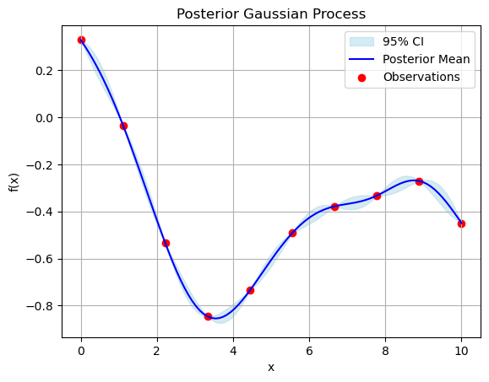
Gaussian Process
This realization of the Gaussian Process using the covariance function defined for calibration with λ, used to compare with target functions like sin(4πx).
Blue line represents the posterior mean of the GP, which is the most likely value of the function at any given point based on the observed data
interval is calculated as μ<pred> ± 2σ <pred>
true function values are likely to lie with 95% probability
Notes:
μpred=Kpred,obsKobs−1yobs
Kpred,pred−Kpred,obsKobs−1Kobs,pred
Increasing λλ: Makes predictions smoother, as points farther apart are more strongly correlated.
Decreasing λλ: Reduces correlation between distant points, making predictions more localized.

Slide 16
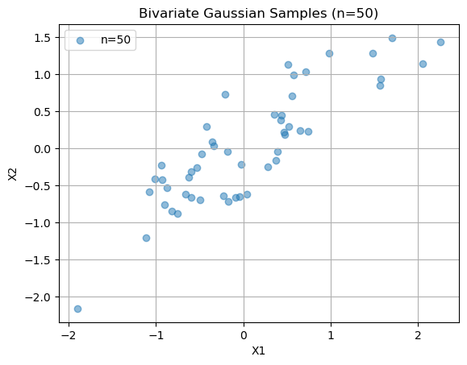
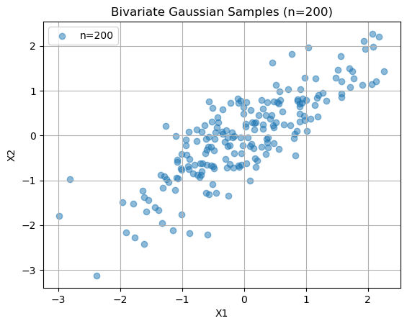
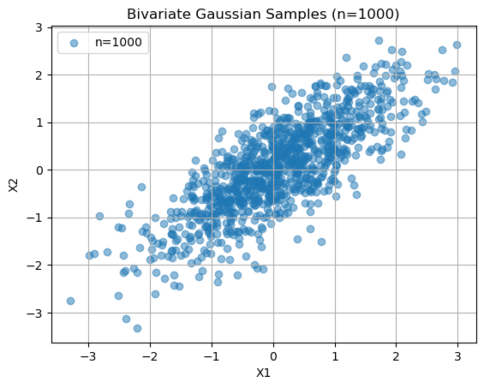
Bivariate Gaussian Samples
In each case, a scatter plot is produced that shows high correlations (for example, with covariance 0.8) between the variables
These plots help illustrate how sample size can affect the density estimation when calibrating models.

Slide 17
Calibration of the hyper-parameters of a gaussian process regressor by maximum likelihood
Bivariate Gaussian Sampling
Visualization: Scatterplots showing correlation (ρ=0.8)
Sample effect: 50 vs 1000 samples demonstrates CLT convergence
Parameter change: Adjust covariance matrix to see different ellipse shapes
Notes:
Data fit term: yᵀK⁻¹y
Complexity penalty: log|K| Balances model accuracy and complexity
Derived from Gaussian conditioning rules: μ = KₛK⁻¹y Σ = Kₛₛ - KₛK⁻¹Kₛᵀ
Represents epistemic uncertainty about unobserved regions

Slide 18
Calibration of the hyper-parameters of a gaussian process regressor by maximum likelihood
mu_pred = K_pred @ K_obs_inv @ y_obs
cov_pred = K_pred_pred - K_pred @ K_obs_inv @ K_pred.T
Bivariate Gaussian Sampling
Visualization: Scatterplots showing correlation (ρ=0.8)
Sample effect: 50 vs 1000 samples demonstrates CLT convergence
Parameter change: Adjust covariance matrix to see different ellipse shapes
std_pred = np.sqrt(np.diag(cov_pred))
plt.fill_between(x_pred, mu_pred±2*std_pred, alpha=0.3)
Notes:
Data fit term: yᵀK⁻¹y
Complexity penalty: log|K| Balances model accuracy and complexity
Derived from Gaussian conditioning rules: μ = KₛK⁻¹y Σ = Kₛₛ - KₛK⁻¹Kₛᵀ
Represents epistemic uncertainty about unobserved regions

Slide 19
Simulate an a posteriori distribution with the Monte Carlo Markov Chain algorithm
modify the true likelihood and the a priori of the ”posterior” function ? Generate a long sequence and take only the second half of the sequence as a representative sample.
With the sample obtained in question 1. make a kernel approximation of the associated density and compare this estimated density with the true objective density of G(k + x,λ+1)?

Slide 20
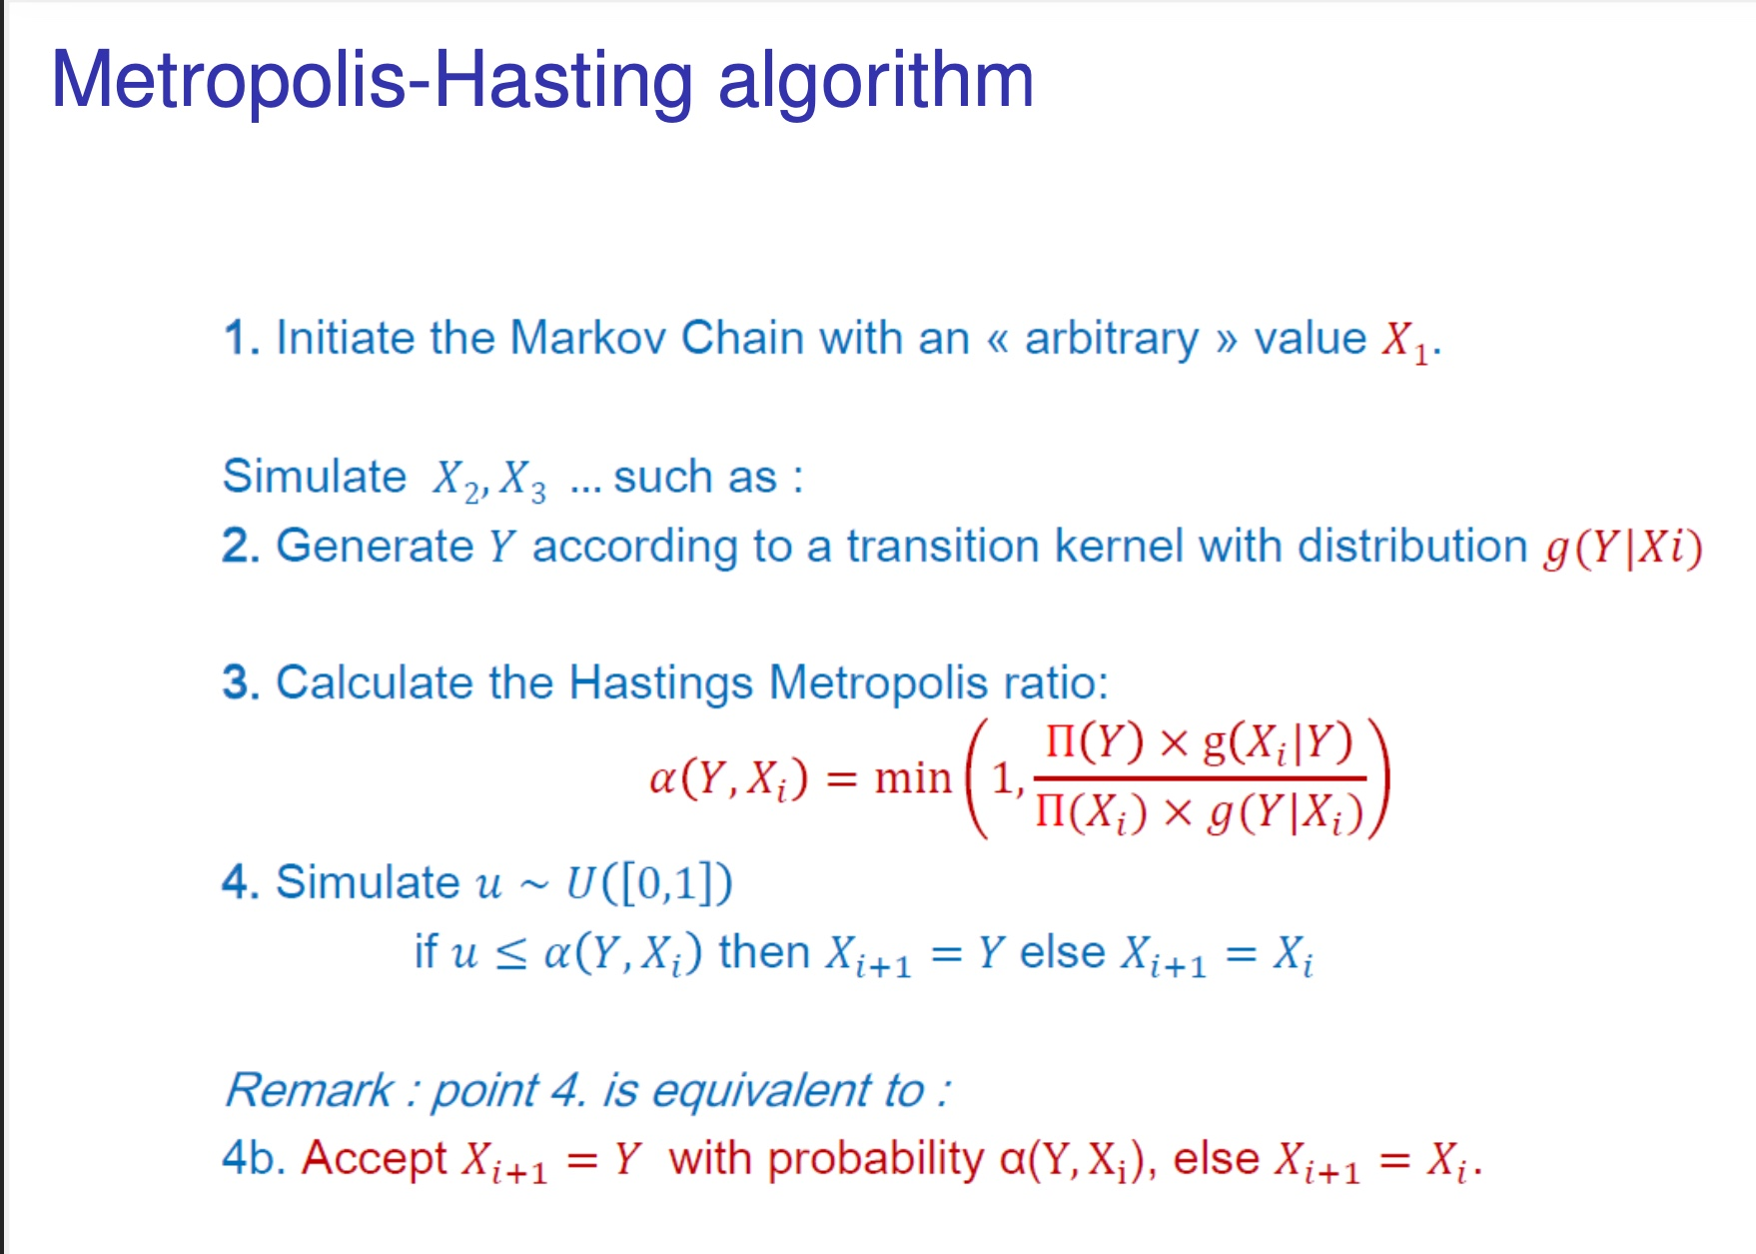
Simulate an a posteriori distribution with the Monte Carlo Markov Chain algorithm

Slide 21
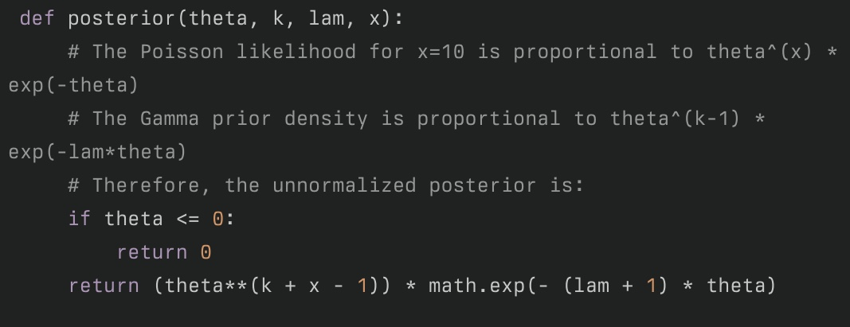

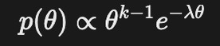
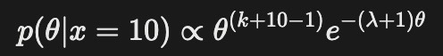
Defining the function?
to sample from the true posterior G(k+10,λ+1) we first write a function that returns the unnormalized posterior density.
Also, in practice, the product of the Poisson likelihood and the Gamma prior
Notes:
Defining the target posterior function
The likelihood is a Poisson likelihood for a single observation x = 10
The prior is a Gamma distribution with parameters kk and λλ
Multiplying these yields the unnormalized posterior density (ignoring constants)

Slide 22
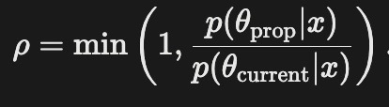
Implementing the Metropolis–Hastings
write an MCMC sampler that uses Metropolis–Hastings
A candidate is proposed and accepted with probability
We initialize theta with a reasonable starting value. Here we use the mode of the posterior k+x−1λ+1λ+1k+x−1 as a heuristic.
We generate a long chain (10,000 iterations) and then discard the first half as burn‐in.
The proposal standard deviation is chosen so that most proposals remain in the positive region.
Notes:
Implementing the Metropolis–Hastings Sampler
A Metropolis–Hastings algorithm is implemented that uses a normal random-walk proposal (rejecting any nonpositive proposals) to generate a long chain. Only the second half of the chain is retained as a representative sample.

